Slide 1
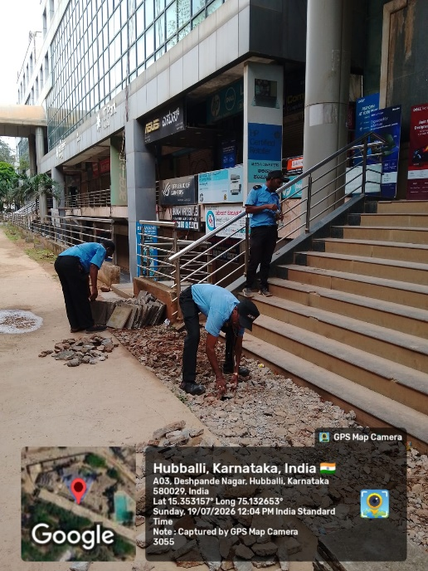
FRONT AREA BEAUTIFICATION BEST OUT OF WASTE Self
Initiative by Security Team
Hubli IT Park

Slide 2
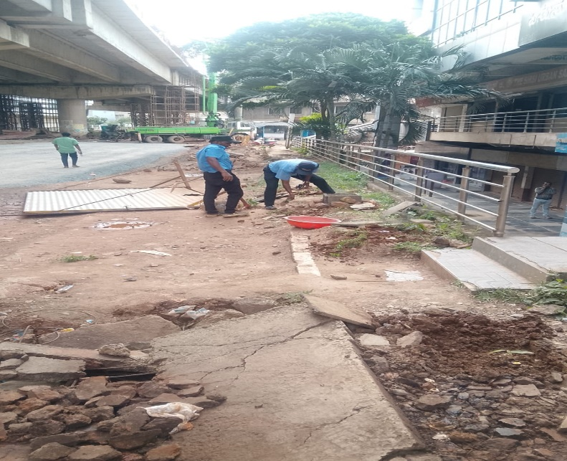
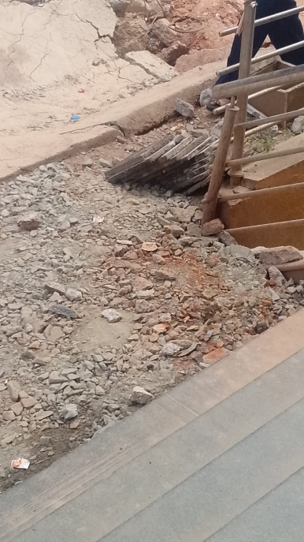
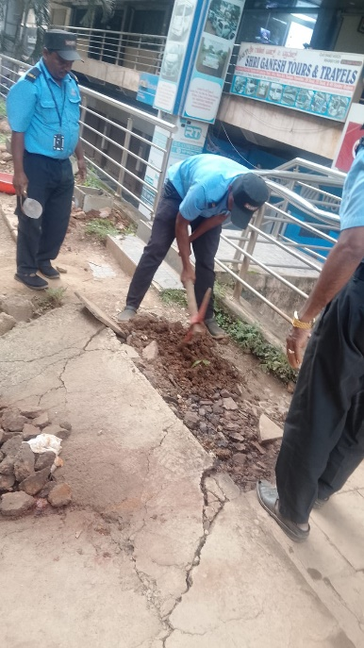
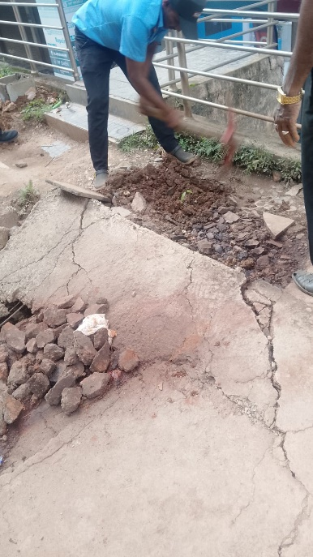
ISSUE IDENTIFIED: The area in front of IT Park building was unclean and full of waste. People used to spit gutka and litter, affecting the beauty of the main building entrance.

Slide 3
ISSUE IDENTIFIED:
The area in front of IT Park building was unclean and full of waste. People used to spit gutka and litter, affecting the beauty of the main building entrance.
ACTION TAKEN:
Our Security Team voluntarily cleaned the entire area, removed waste and levelled the ground. Waste tiles were reused for flooring and saplings were planted to beautify the entrance.
RESULT:
Now the front area looks clean, neat and beautiful, improving the overall image of IT Park.

Slide 4
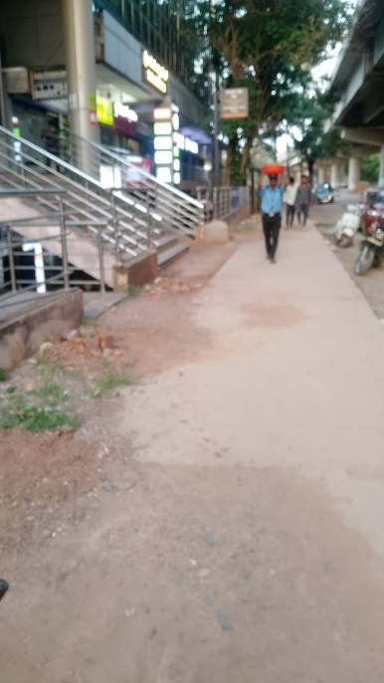
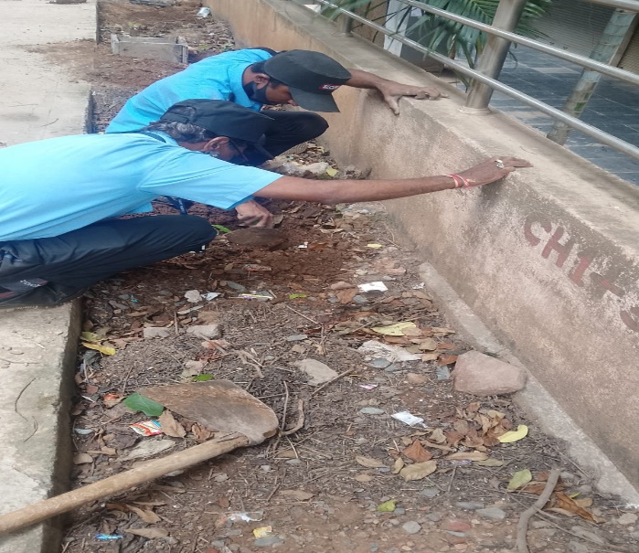
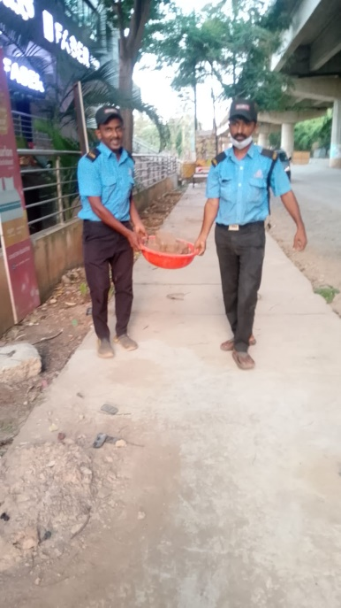
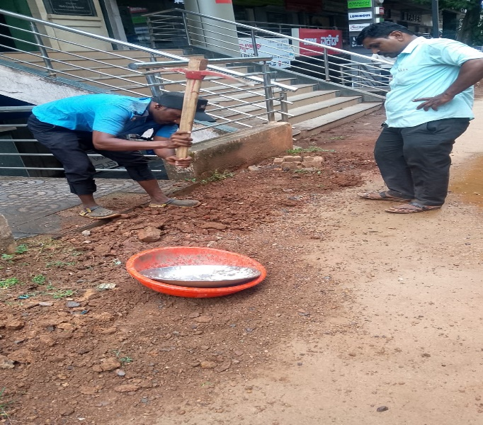
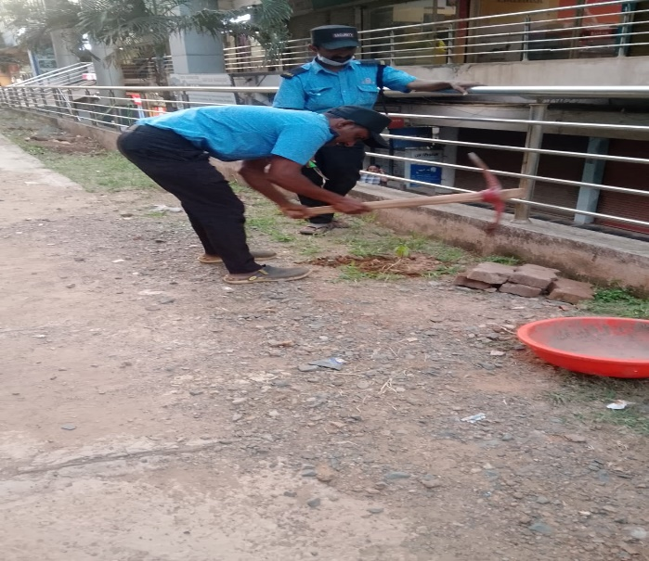
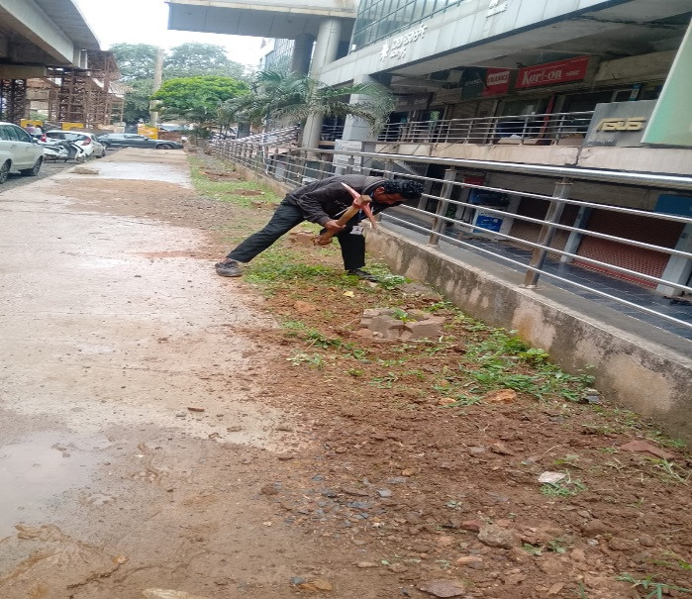
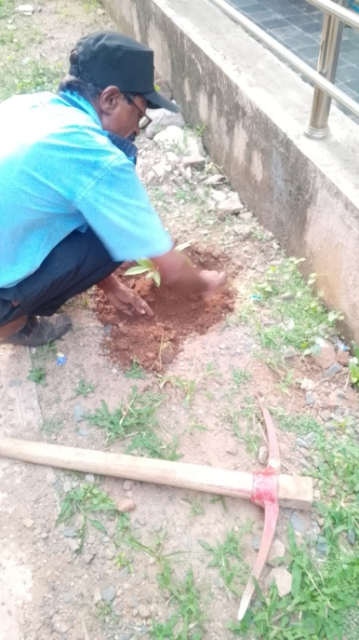
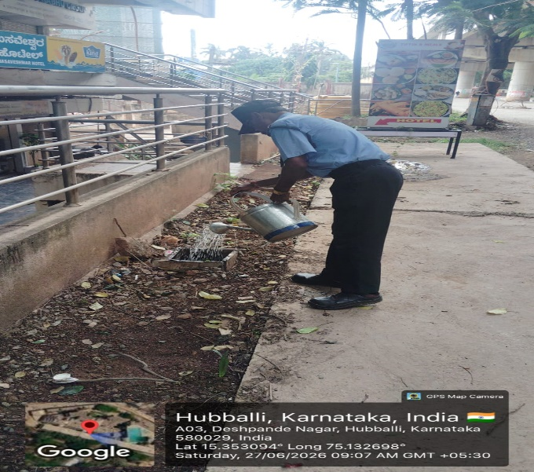
Before: Unclean area with gutka stains & waste

Slide 5
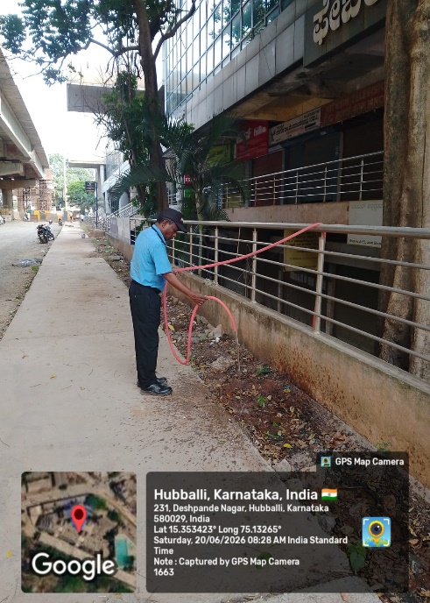
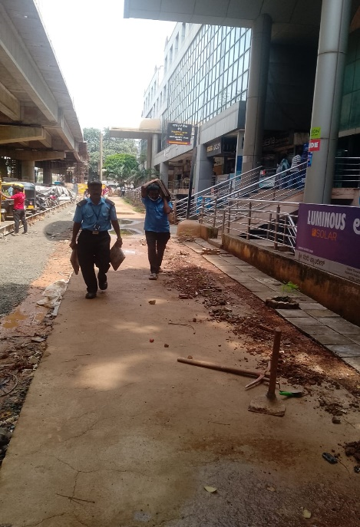
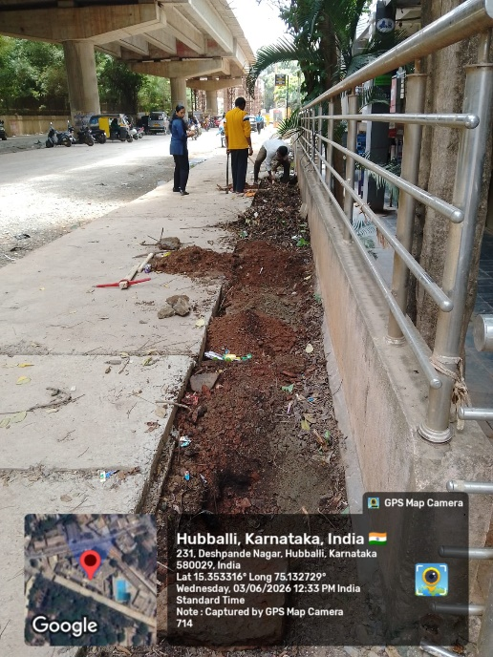
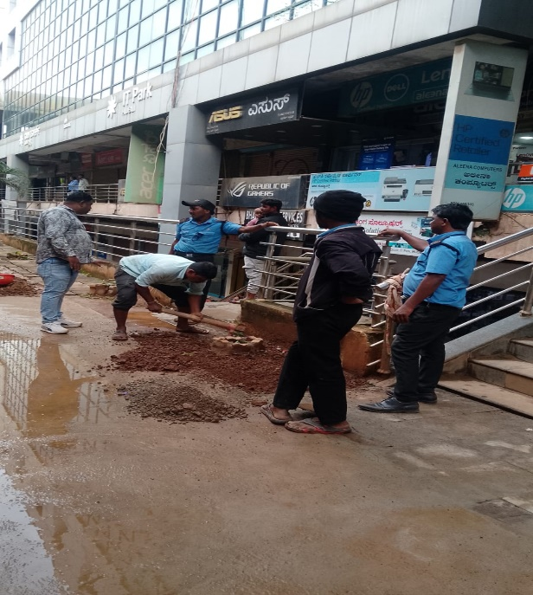
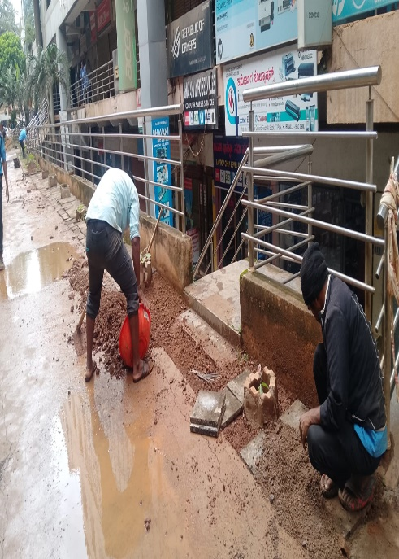
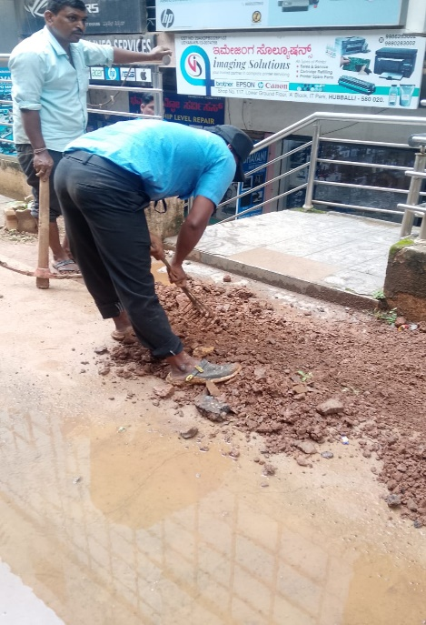
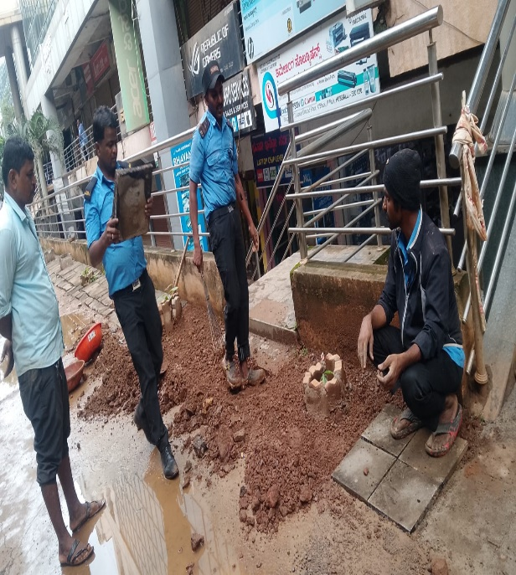
Cleaning in Progress by Security and Housekeeping Team

Slide 6
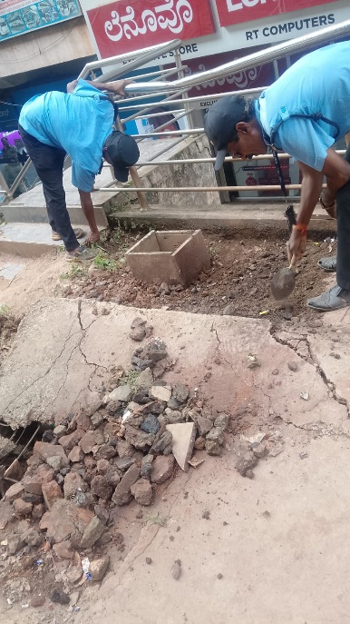
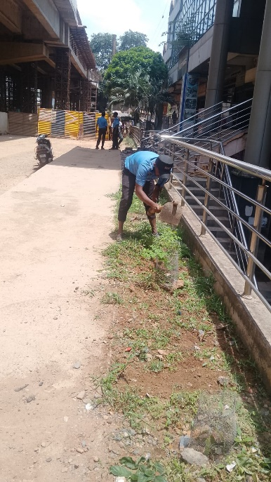
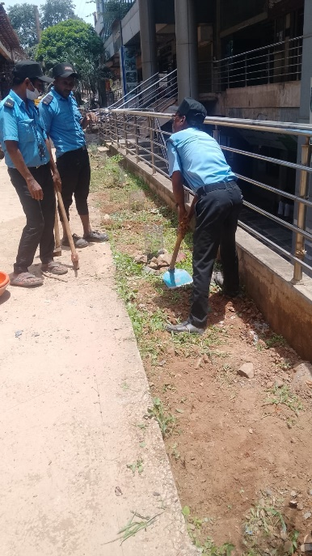
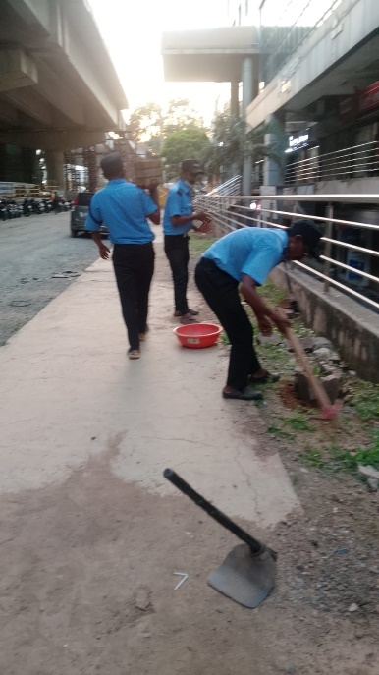
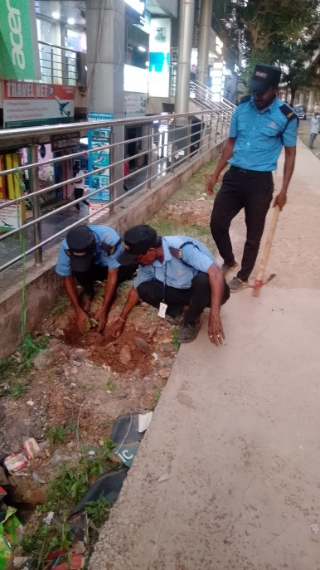
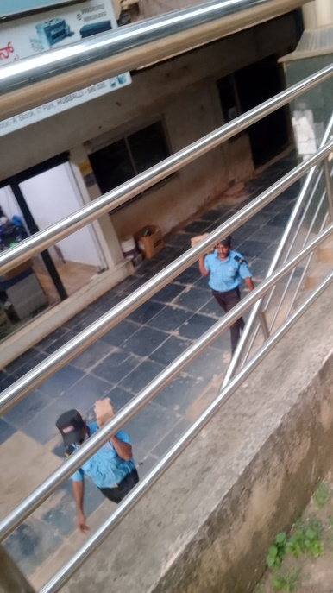
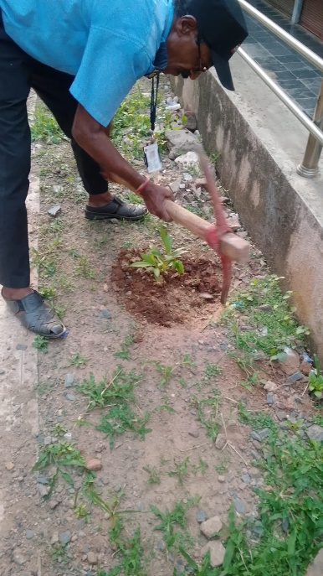
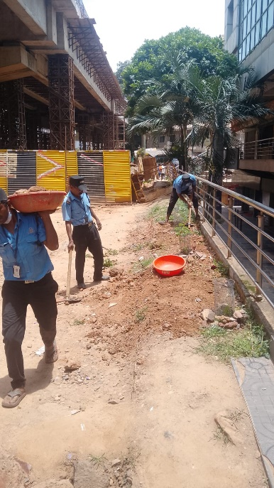
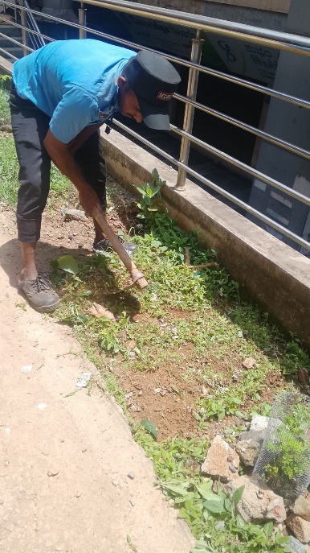
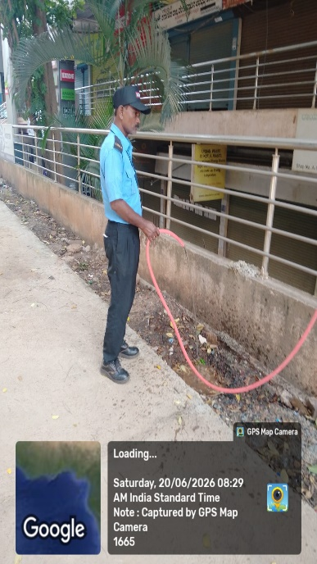
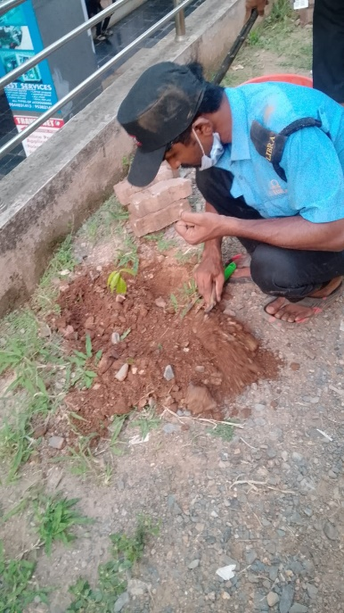
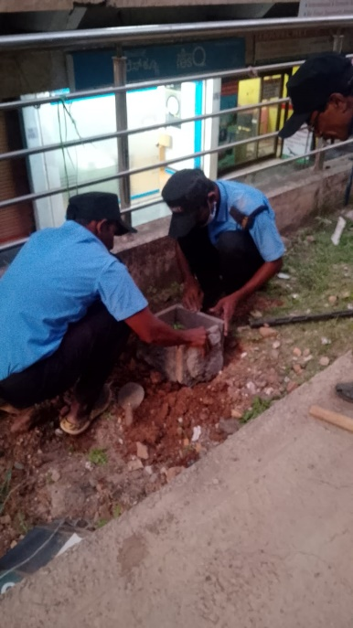
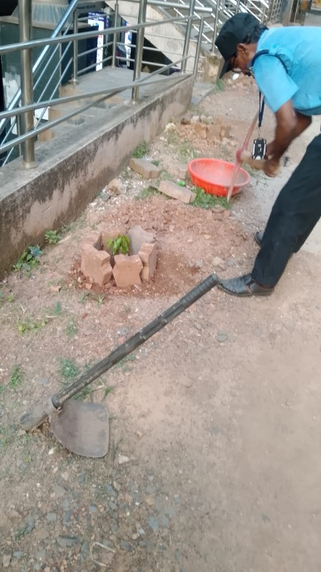
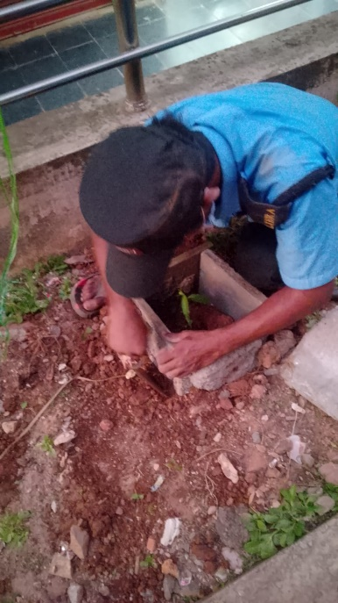
Levelling & Preparation Work

Slide 7
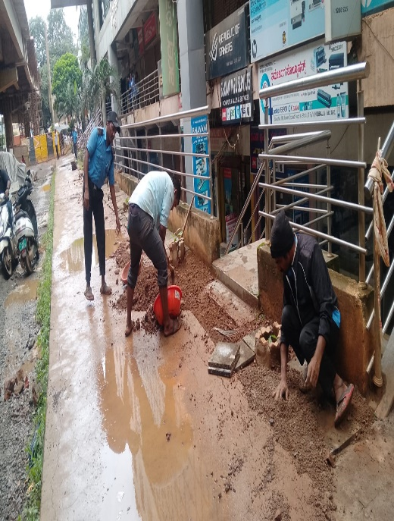
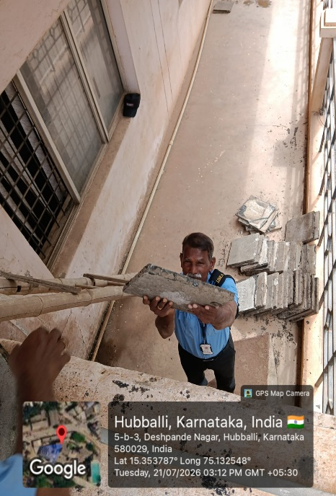
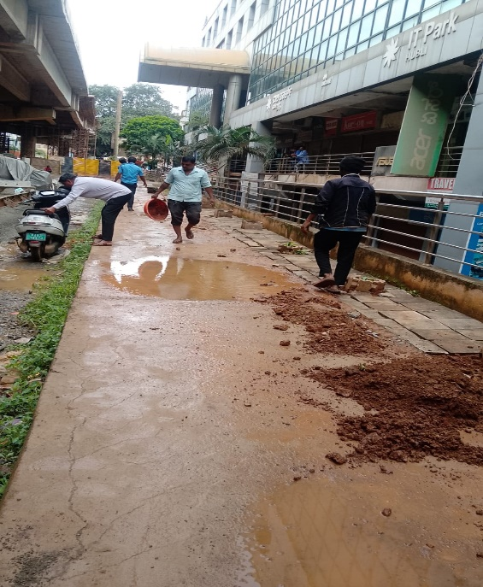
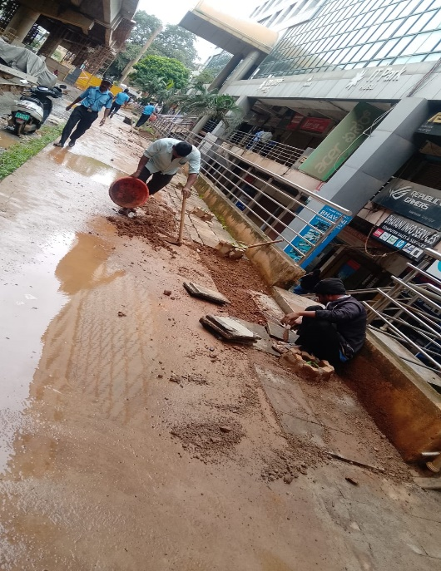
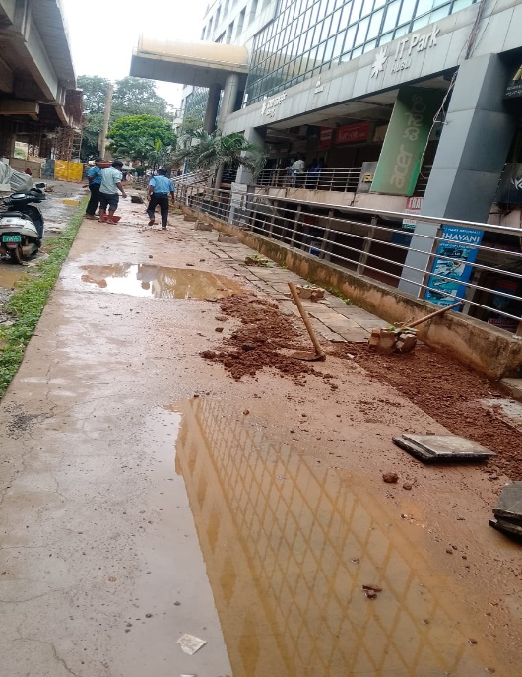
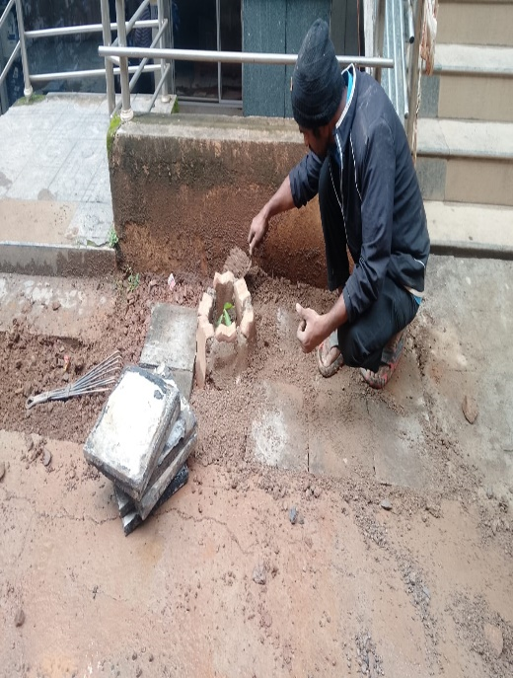
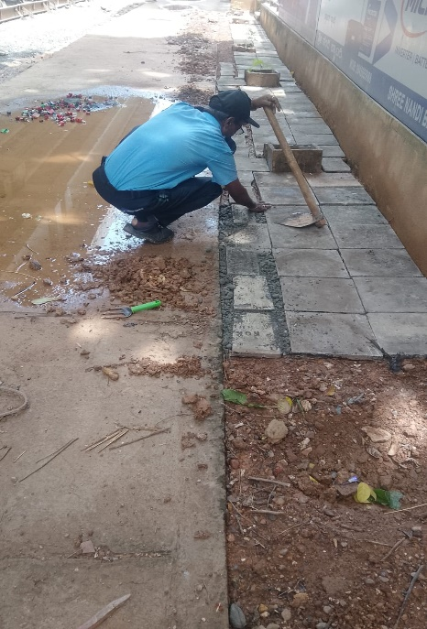
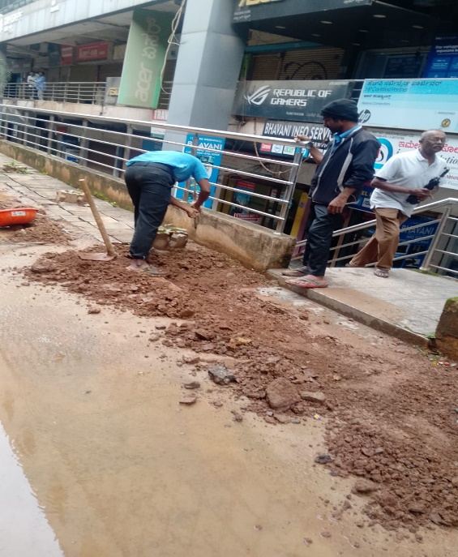
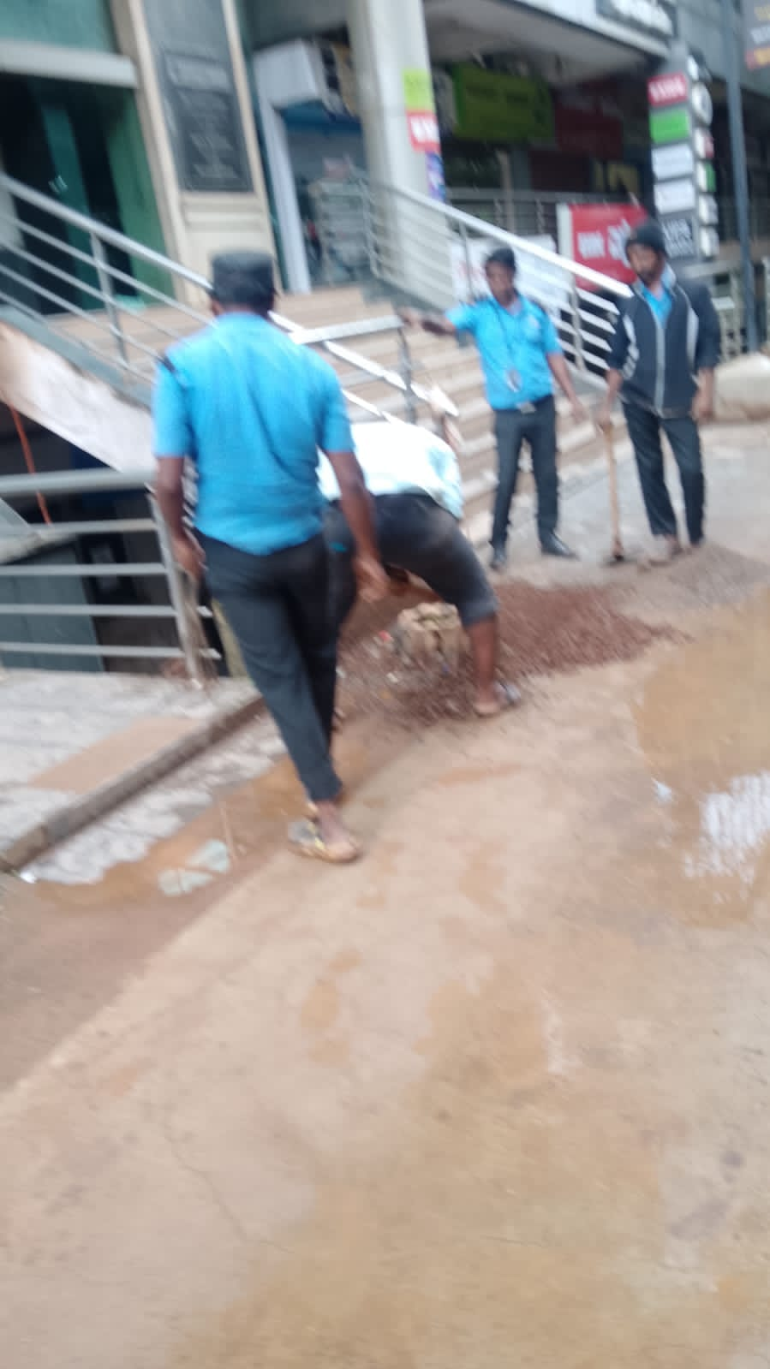
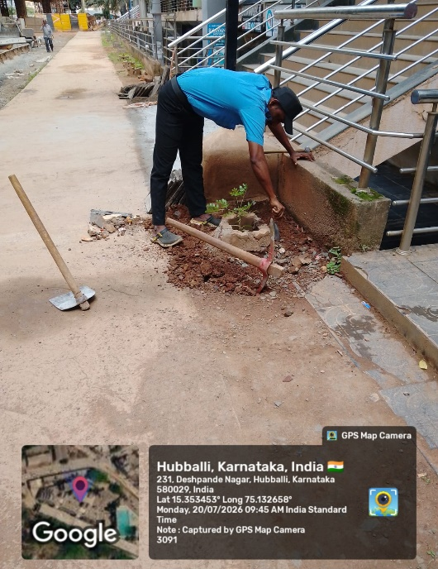

Slide 8
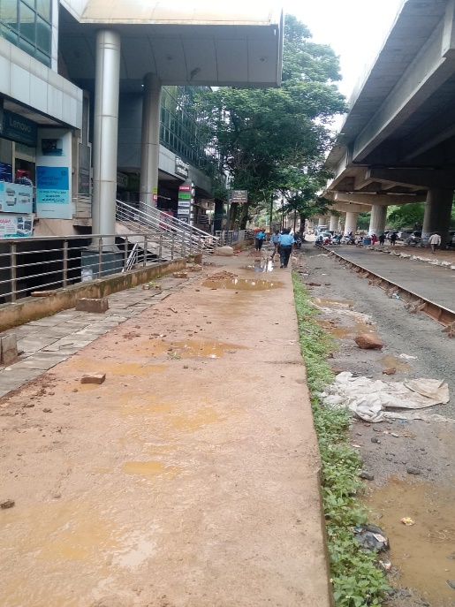
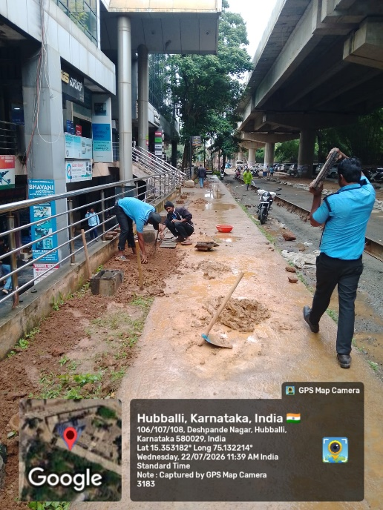
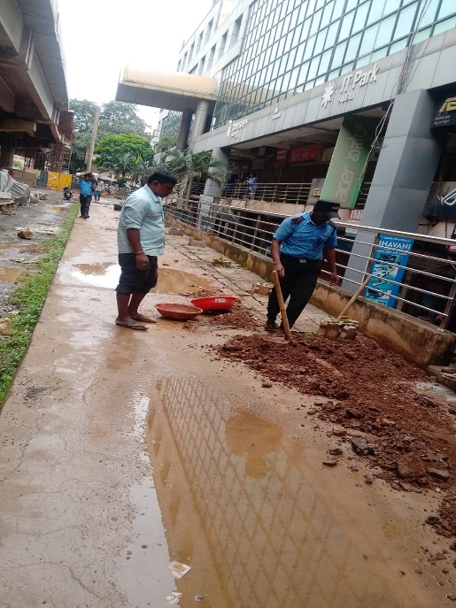
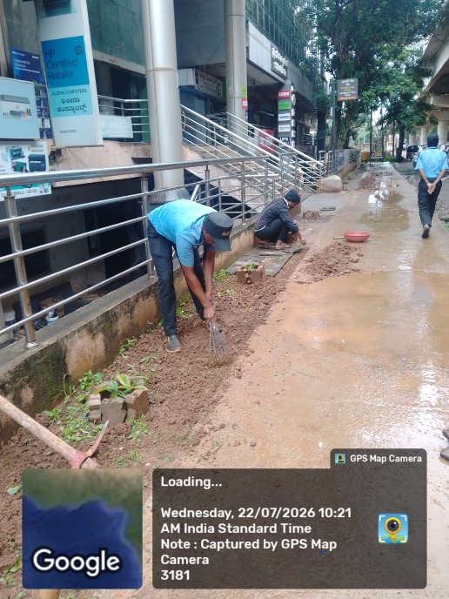
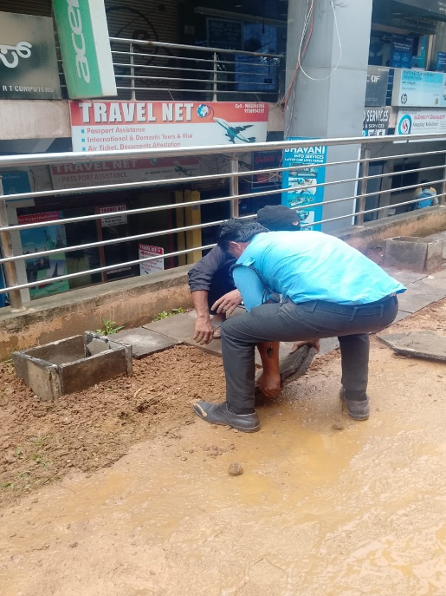
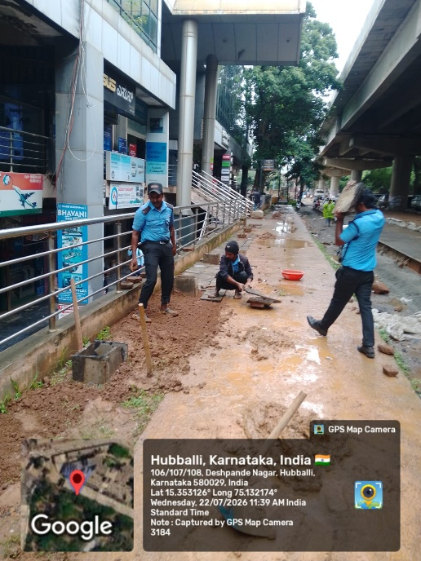





Slide 9









Slide 10








Plants Planted and Protected Using Waste Tiles

Slide 11











Slide 12









Slide 13







BEST OUT OF WASTE - FLOORING WORK
Waste Tiles Reused for Lobby-1 & Lobby-2 Entrance Flooring

Slide 14






RESOURCE COLLECTION FROM TERRACE
Security Team Bringing Waste Tiles from Terrace for Reuse

Slide 15









WASTE TILES SHIFTED FROM TERRACE TO GROUND FLOOR
By Security Team for Reuse at Lobby-1 & Lobby-2

Slide 16










Waste Tiles Reused for Flooring at Lobby-1 & Lobby-2 Entrance

Slide 17








BEAUTIFICATION WITH PROTECTION
Flooring Work Along with Plantation & Tile Protection for Saplings at Front Side

Slide 18









BEST OUT OF WASTE - FLOORING WORK
Waste Tiles Reused for Lobby-1 & Lobby-2 Entrance Flooring

Slide 19





SUSTAINABLE INITIATIVE: WASTE TILES REUSED Flooring Work Completed at
Lobby-1 & Lobby-2 Entrance by Security Team

Slide 20



SUSTAINABLE INITIATIVE: WASTE TILES REUSED Flooring Work Completed at Lobby-1 & Lobby-2 Entrance and front footpath area with planted by Security Team

Slide 21
THANK YOU FOR WATCHING

